Slide 1
Open House
Thank you for your interest in St. John Primary. Hopefully, the information in this slideshow will help you know more about our school. More information can be found on our school website
www.sjp-sta.org.
Enjoy the presentation!
Admission Process begins December 1

Slide 2
Back in 1959 . . .
St. Theresa of Avila School opened in 1959 with 276 students (Fr. Lieux was the pastor at that time.)
The only grades in the school were 1st through 4^{th.}
The school was originally under the administration of the Sisters of the Most Holy Sacrament.
We started many years ago.

Slide 3
EAST ASCENSION/EAST IBERVILLE REGIONAL CATHOLIC SCHOOL PARTNERSHIP
We are very unique; we are a partnership of nine Catholic church parishes with seven pastors. We have two campuses
and two principals, yet we are
ONE SCHOOL.
Our official school name is . . .
St. John Primary/St. Theresa Middle

Slide 4
. . . and now in 2022-2023
We now serve about 735 students in grades PK-8th on two campuses.
Pre-Kindergarten - Third grade = St. John Primary
Fourth - Eighth grade = St. Theresa Middle
Our students represent the following church parishes:
St. John the Evangelist (Prairieville)
St. Joseph (French Settlement)
St. Mark (Gonzales)
St. Stephen (Whitehall)
St. Theresa of Avila (Gonzales)
Our Lady of the Holy Rosary (St. Amant)
St. Anne (Sorrento)
St. Anthony (Darrow)
St. Gabriel (St. Gabriel)

Slide 5
St. John Primary
372 students in grades PK to 3rd
3-4 sections of each grade level
average number of students per homeroom this school year:
  PK = 23
  K = 18
  1st = 19
  2nd = 20
  3rd = 27
On this campus, we have all the younger students.

Slide 6
St. Theresa Middle
362 students in grades 4th through 8th
4th and 5th graders have departmentalized classes, yet remain in homeroom groups
6^{th-}8th graders have a “high-school” type schedule throughout the day
Math and English high school courses are offered for 8th graders
The ‘big kids’ are on this campus.

Slide 7
MISSION STATEMENT
The mission at
St. John Primary/St. Theresa Middle
is to serve one another through Catholic values
as we strive for spiritual growth
and academic excellence.

Slide 8
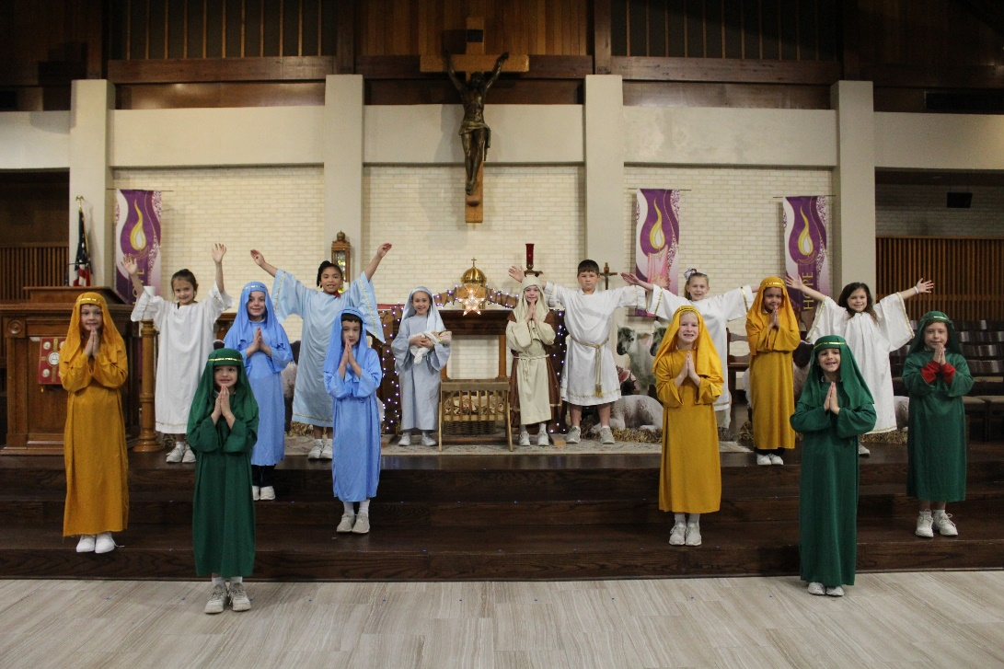
SPIRITUAL GROWTH
BE THE BEST THAT GOD CREATED YOU TO BE
Daily Prayer
Weekly school Masses
Masses for 2nd & 3rd grades
Retreats for 1st - 3rd grades
Visits by partnership priests

Slide 9
ACADEMIC EXCELLENCE
BE THE BEST THAT GOD CREATED YOU TO BE
Diocesan Standards adapted to our curriculum from the Common Core State Standards
Rigor, Relevance, and Relationships
Actively engaged learners
Standardized testing in 3^{rd-}8th grades
Honor Roll recognition for students in 3^{rd-}8th grades

Slide 10
A day in the life - PK and K
Before Care on either campus (6:45 a.m.)
Morning Prayer Assembly
Academics
  Religion, Math, Language Arts, Science and Social Studies
  Social, motor, and physical activities in “Centers”
  Art and Music
  Weekly Enrichment Classes: Library and Music for PK and Library, Art, Music, PE, and Computer for K
Lunch and recess
Academics continued
Naps
Dismissal
After Care on STA campus (until 6:00 p.m.)
Our littlest students have quite a busy day!
The pictures on the next few slides display a variety of activities
that take place throughout a school day.

Slide 11
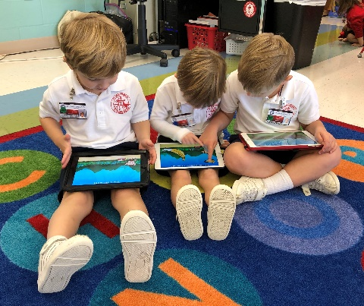
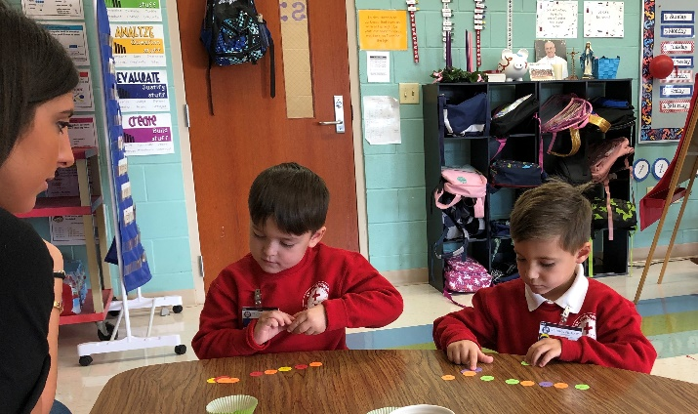
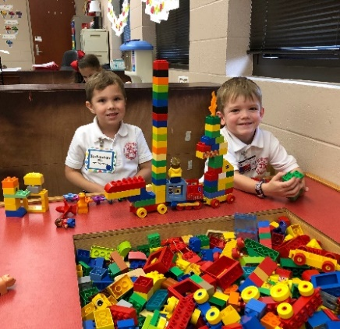
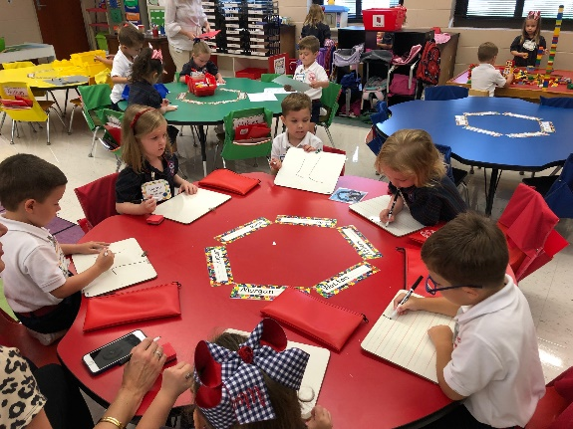
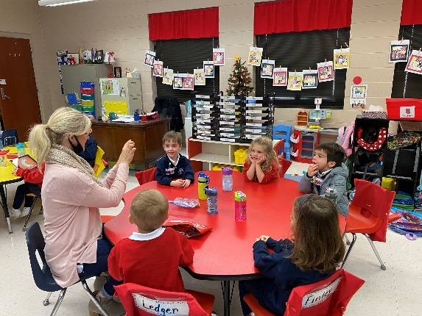
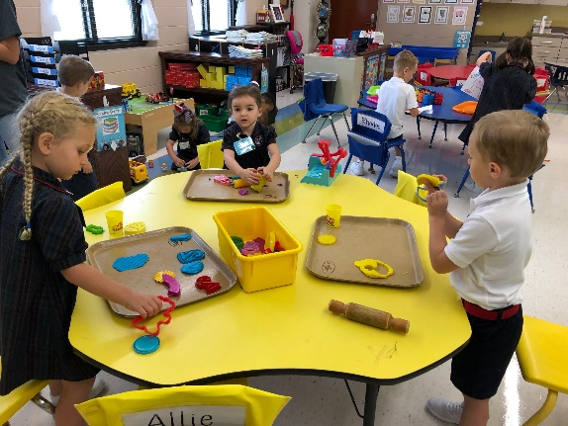
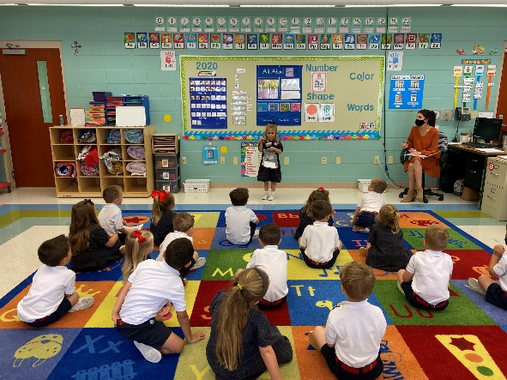
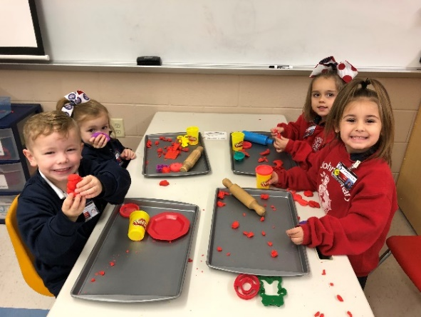
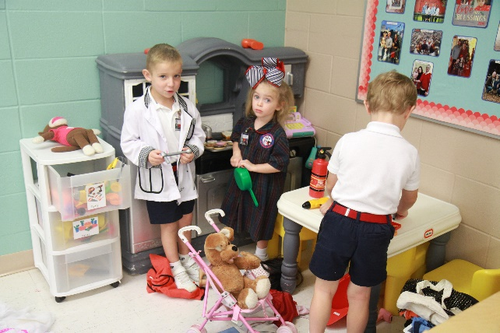
Pre-Kindergarten Classroom Learning and Centers

Slide 12
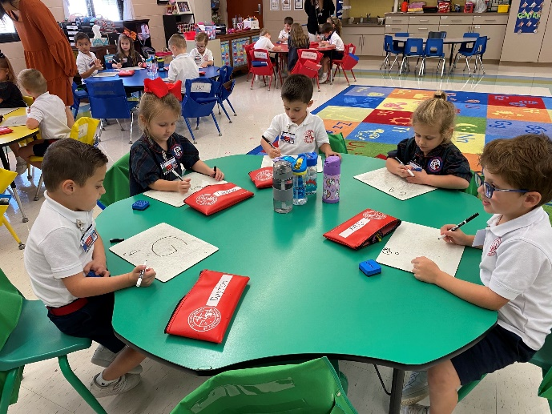
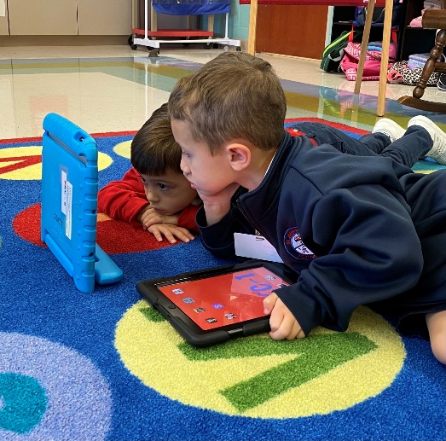
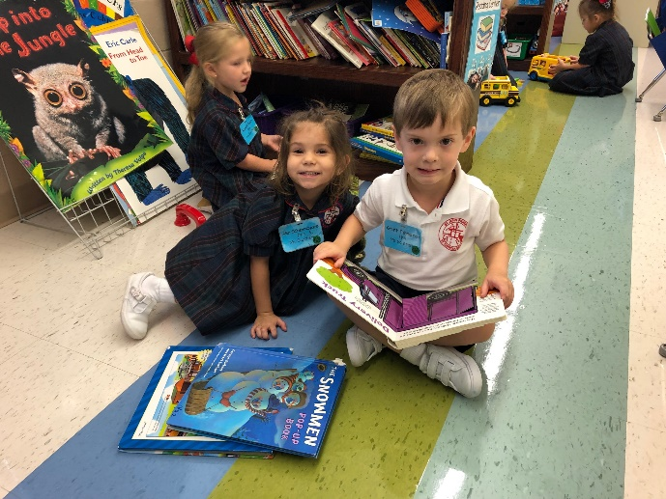
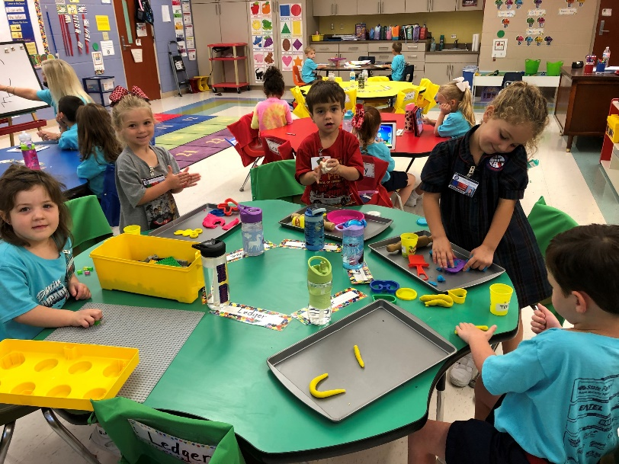
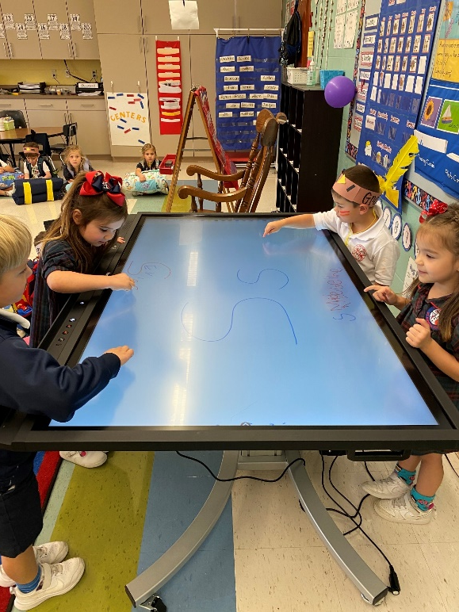
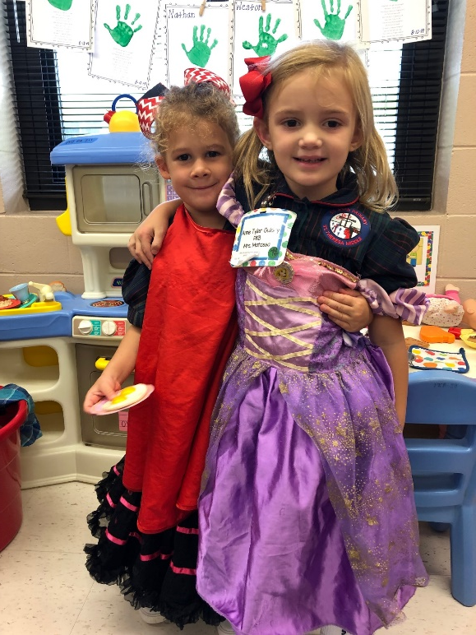
Pre-Kindergarten Classroom Learning and Centers

Slide 13
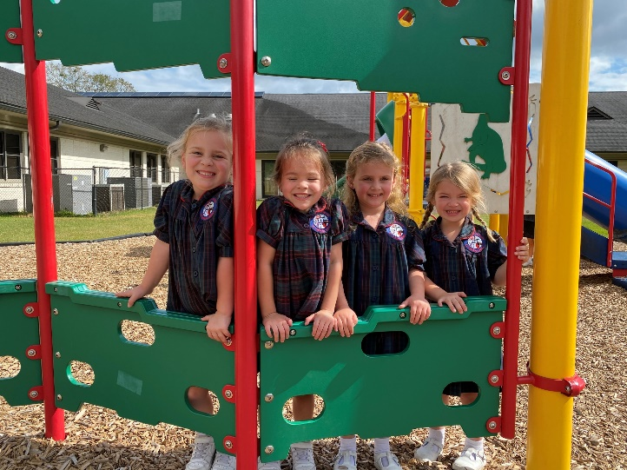
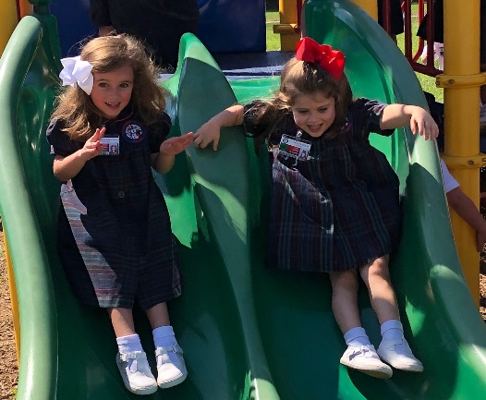
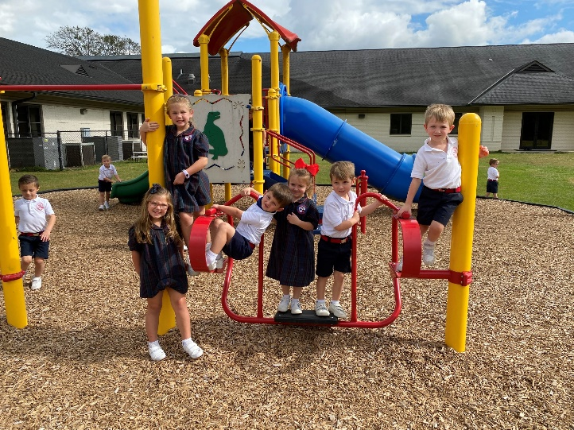
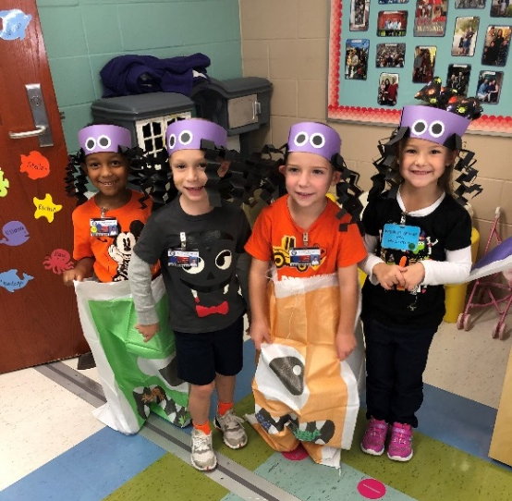
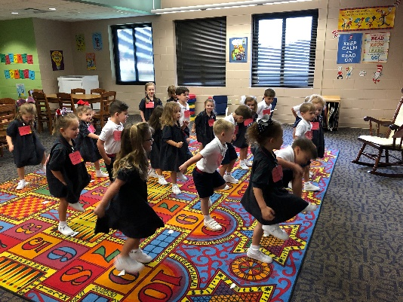
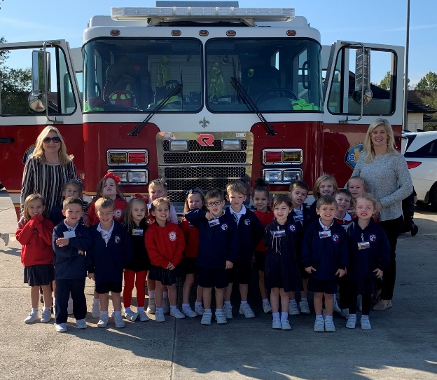
Pre-Kindergarten Learning and Playground Fun

Slide 14
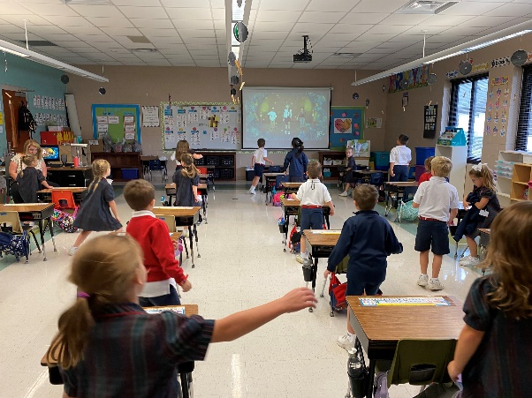
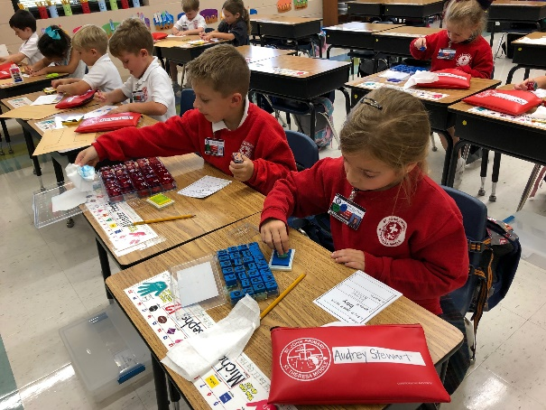
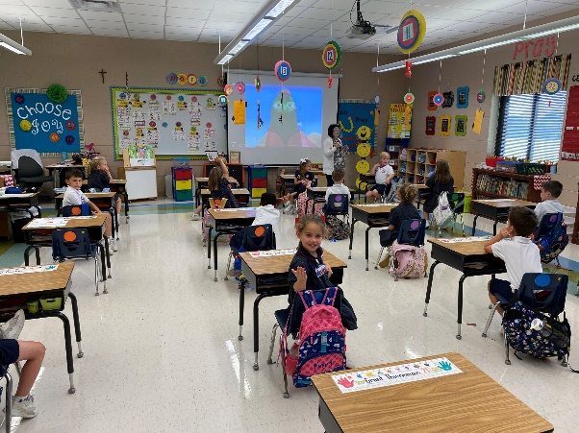
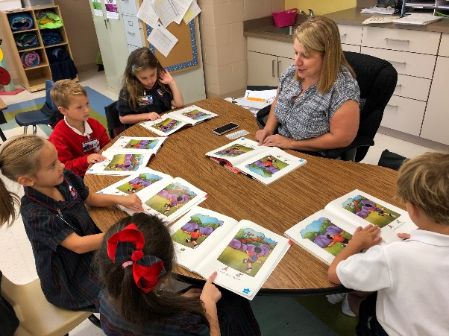
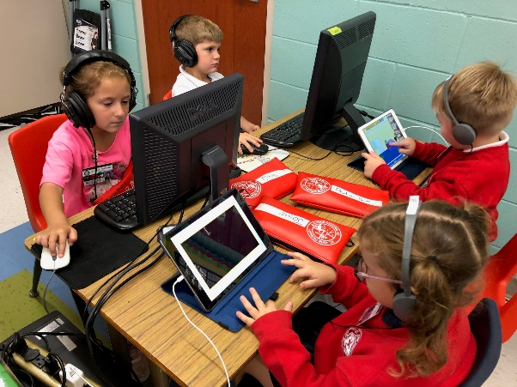
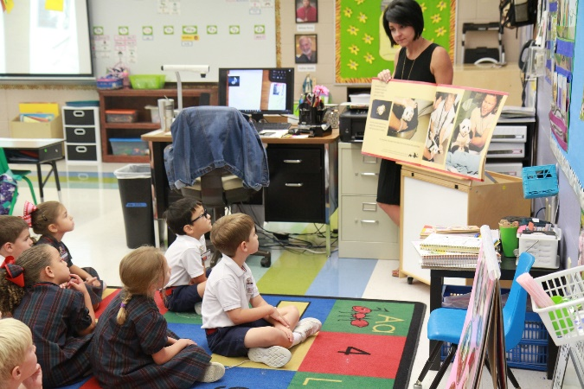
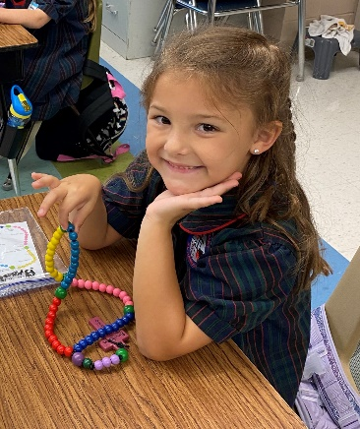
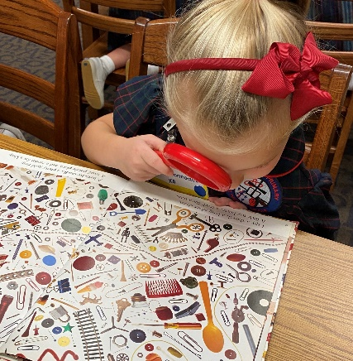
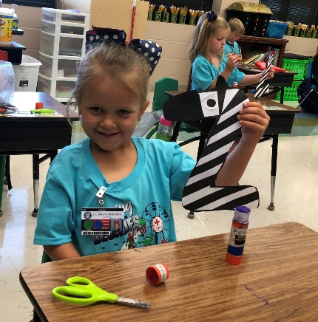
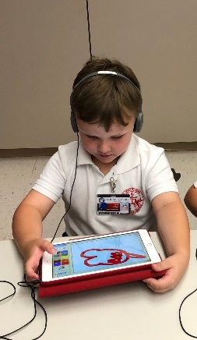
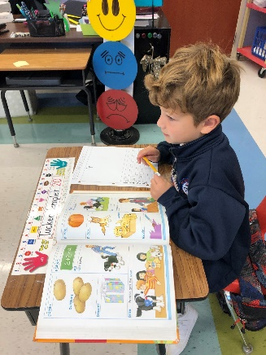
Kindergarten Classroom Learning

Slide 15
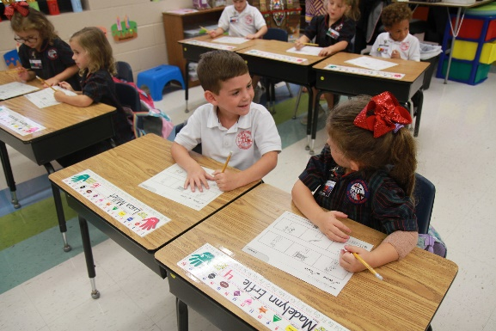
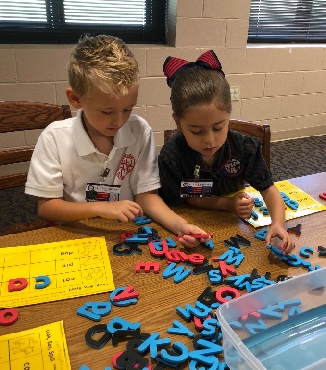
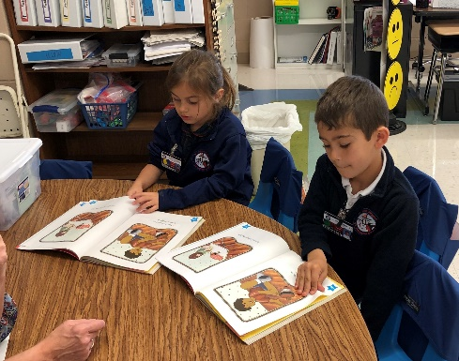
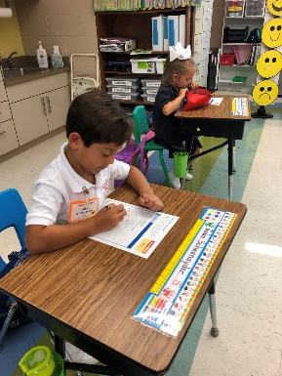
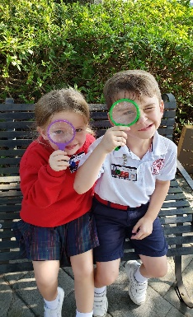
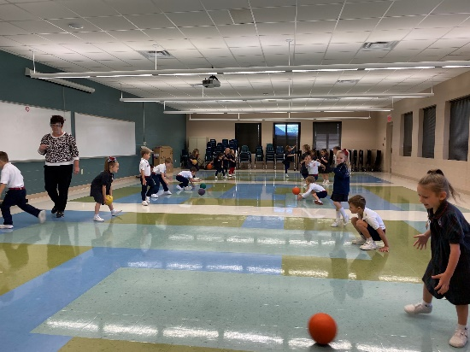
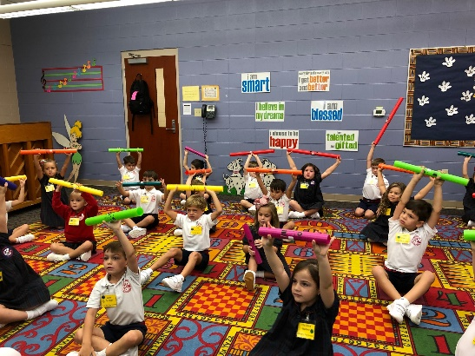
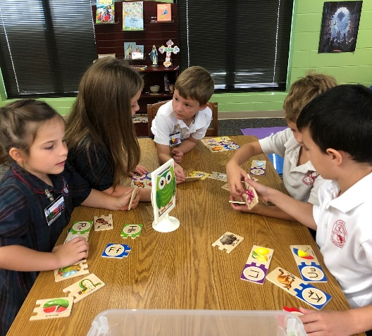
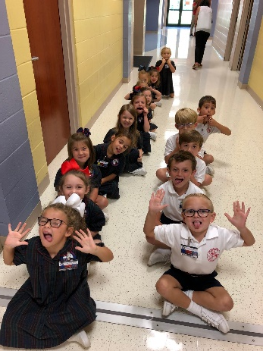
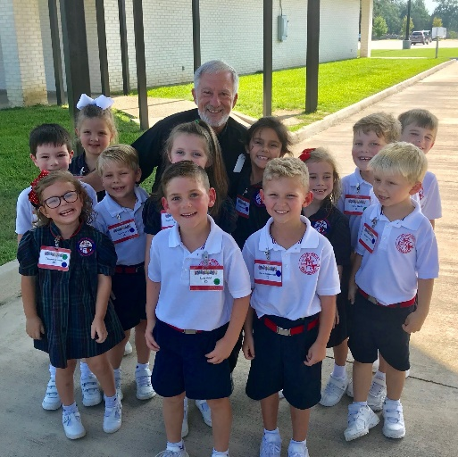
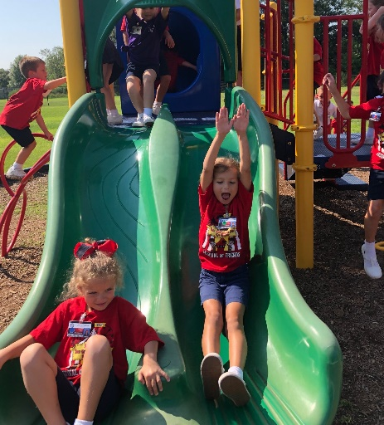
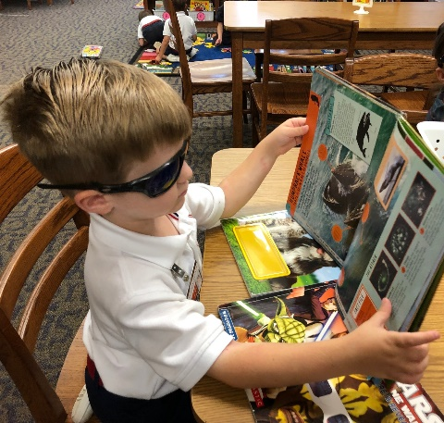
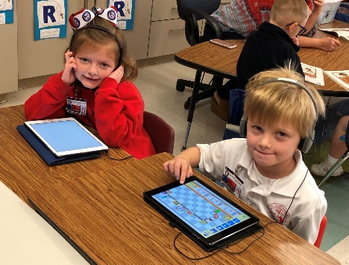
Kindergarten Classroom Learning and Fun

Slide 16
Application Process
School website www.sjp-sta.org
  Click on ADMISSIONS
Online Application Form – Be prepared to upload, print, and pay:
  Photo of applicant
  Forms to download and print
  $65 non-refundable fee
  Admissions Secretary: Mrs. Tracie Waguespack
    Office on St. Theresa Middle campus
    traciewaguespack@sjp-sta.org
    Contact for application assistance
  St. John Primary Principal’s Secretary: Mrs. Shannon Meng
    Office on St. John Primary campus
    shannonmeng@sjp-sta.org
    Contact for school information

Slide 17
More about the application process . . . for PK and K . . .
One of the forms to download and print is called the Parish Verification Form. Complete the form and bring to your pastor. He will sign it and send it directly to the school office. This could take several weeks.
Another form to download and print is the Readiness Form. Complete the form and bring to Mrs. Waguespack’s office, along with other forms:
  original birth certificate
  a current immunization record
  copy of a baptism certificate
Applications should be completed as soon as possible, although we will accept applications throughout the summer, as long as there is room.
Our goal is to mail the first round of acceptance letters around mid-February.
There are acceptance priorities, as stated on the next slide.

Slide 18
Acceptance Priorities for St. John Primary/St. Theresa Middle
A Catholic family is a family who is registered and verified in a Catholic Church parish.
An applicant is a baptized or non-baptized child. The order of priority for admission to St. John Primary/St. Theresa Middle is as follows:
Applicant in a Catholic family with a currently enrolled student in St. John Primary/St. Theresa Middle OR whose next older sibling has graduated from the 8th grade at St. Theresa Middle
Applicant with a Partnership Parish Verification Form identifying the family as a member of one of the nine partnership church parishes (Applicants from any Partnership parish have equal status throughout the application process.)
Applicant in a Catholic family transferring from another Catholic school
Applicant from a Catholic parish choosing not to participate in the Partnership
Applicant in a non-Catholic family (Non-Catholic families will not receive official notification of acceptance until June 1.)

Slide 19
2022-2023
Parent/Student Handbook
Age requirements
  PK students must be 4 by September 30.
  K students must be 5 by September 30.
  PK and K students must be completely potty-trained. Teachers do not help students with restroom needs.
Immunization requirements (no policy for COVID immunizations)
  Students must have all immunizations before entering school.
  There are no exemptions accepted for personal or religious reasons.
Tuition and fees
  The current tuition and fee amounts are listed in the 2022-2023 Parent/Student Handbook, which may be found online on our website, under the tab “Campus Life.”
  Next year’s tuition and fees have not yet been finalized.
  Ask me about Tuition Scholarship Programs.
Great source of information!
Each year, the Parent/Student Handbook is updated over the summer.

Slide 20
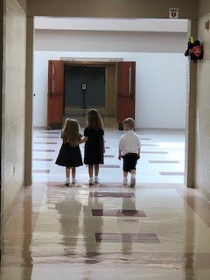
Thank you for sharing your time with us today.
“Little children, love one another.”
. . . St. John the Evangelist

